Slide 1
3PL Text File Converts to Excel

Slide 2
Overview
The tool is used for 3PL inventory snapshot files convert to files with Excel file,
and it follow user’s requirement to remove unavailable characters.
The tool is developed via Microsoft Visual Studio 2010 with C# language.
Running environment - Windows 7(32/64 bit) + .Net Framework 4.0.
It can run in two modes – Windows Form and MS-DOS command line.

Slide 3
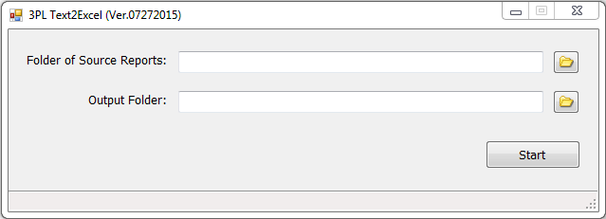
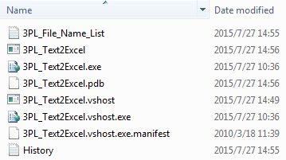
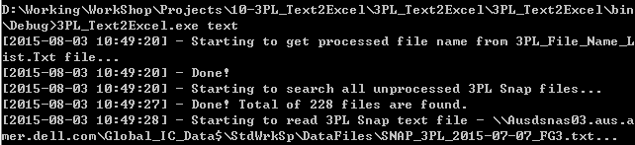
Running Mode
Windows form
MS-DOS Command line – “3PL_Text2Excel.exe Text”

Slide 4
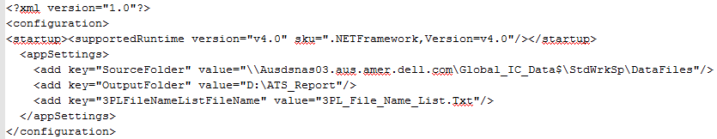
Configuration of the tool
Output folder in “3PL_Text2Excel.exe.Config” file
SourceFolder – Specify the source folder of 3PL inventory snapshot text files.
OutputFolder – Specify the output folder that converted excel files.
3PLFileNameListFileName – The file keeps the file name list that have been converted from text to excel format.

